Slide 1
Outfit Builder
08.14.2014

Slide 2
The Team
Jared O’Rourke – PM
Neha Kesari – PM
Laurie Cai – UX
Maggie Paveza – UR
Bryan Goodyear - TPM
Nishant Bansal – BEZ
Kaitlin Huben – BEZ
Matthew Muiter – FEZ
Julian Owyong – FEZ
Notes:
Name
School
Position

Slide 3
Agenda
  The Problem
  Our Solution
  Demo
  Q & A

Slide 4
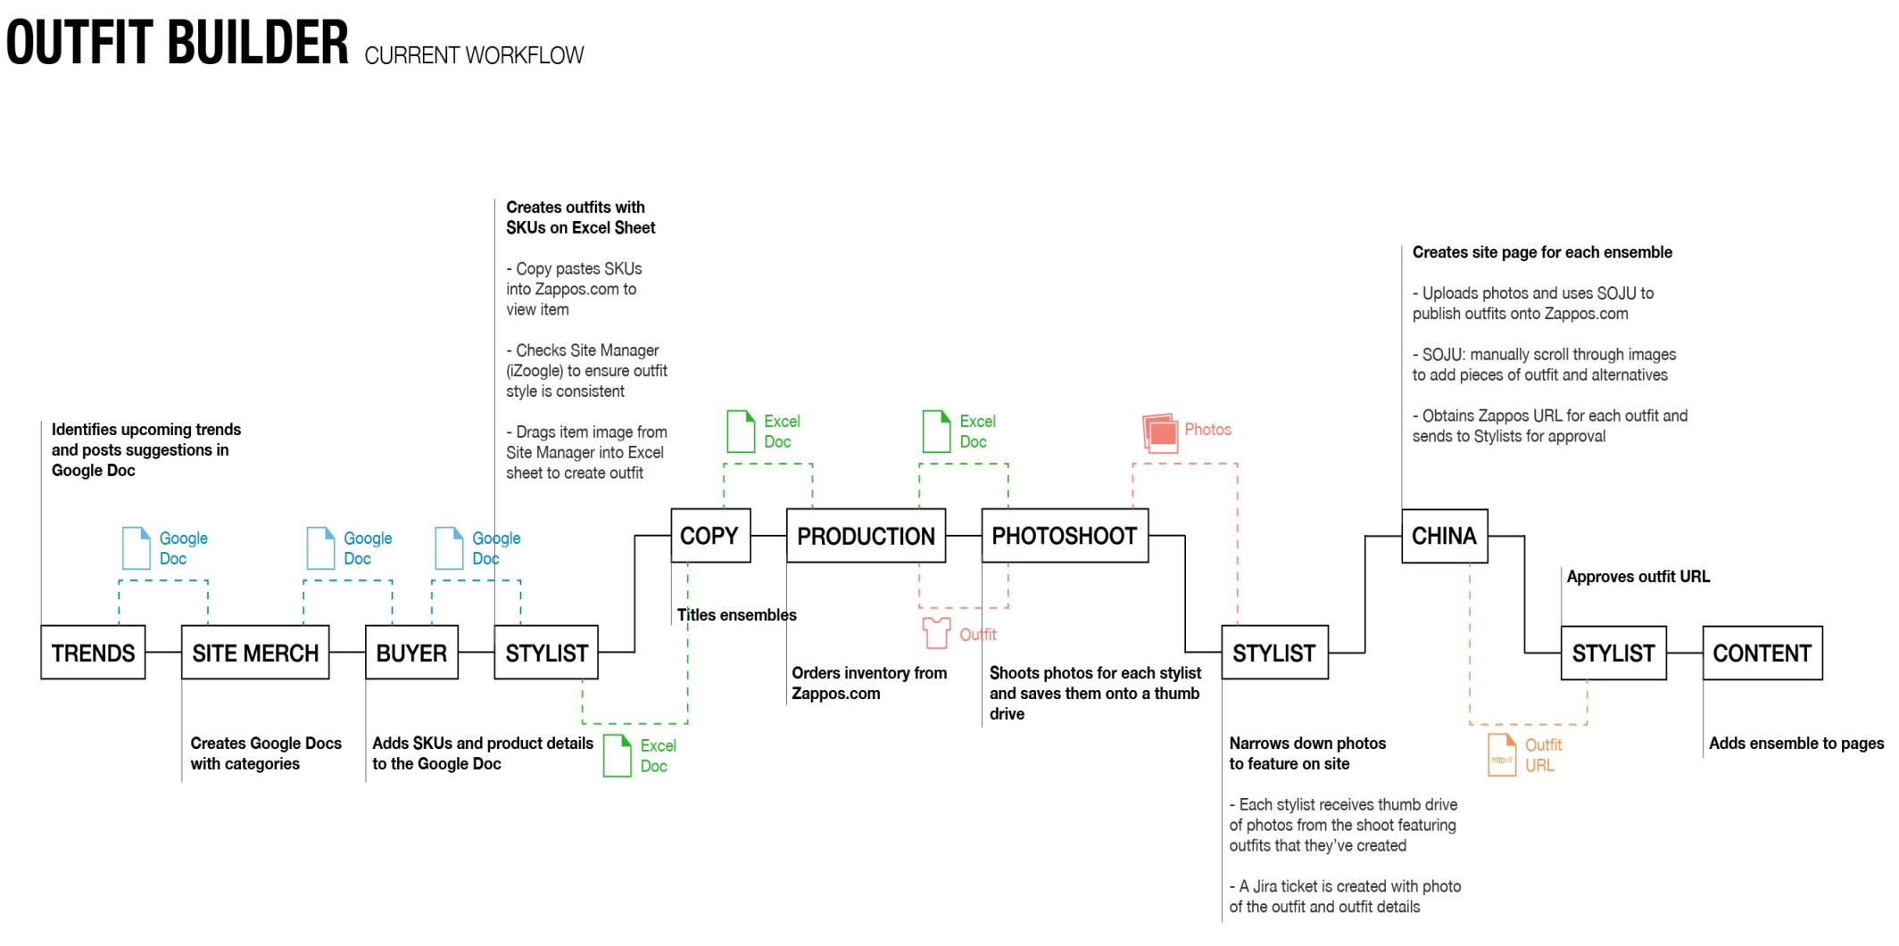
Notes:
This shows the process from conception of the outfit to compilation of outfit SKUs to the photoshoot of the model to publishing on the website.
Briefly explain process
39 days on average process for 1 outfit.
80-100 outfits are created a month – for outfits page and heroes

Slide 5
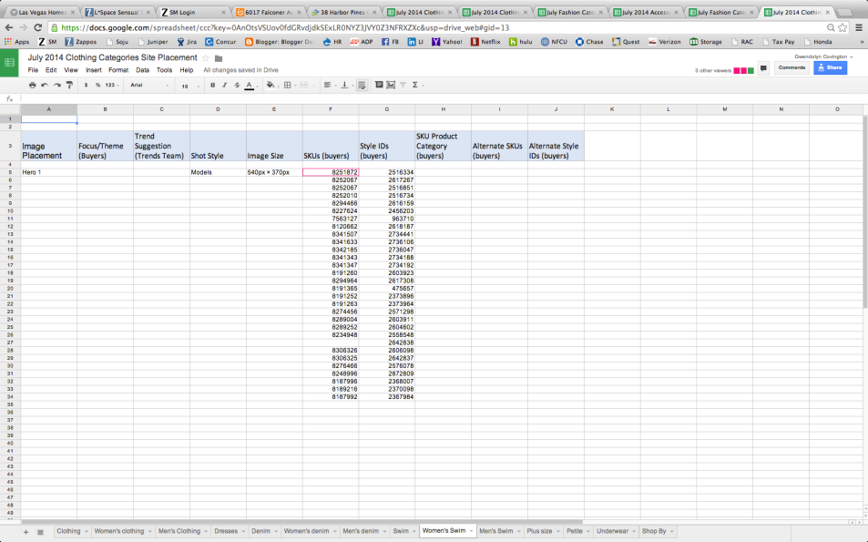
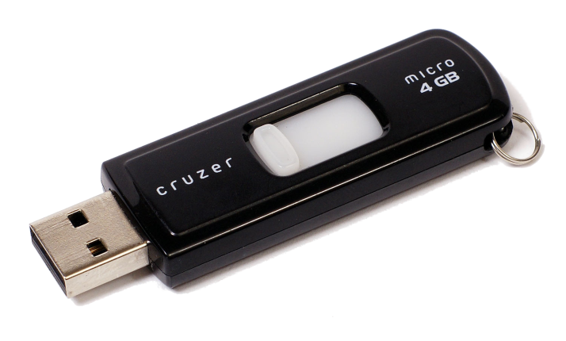
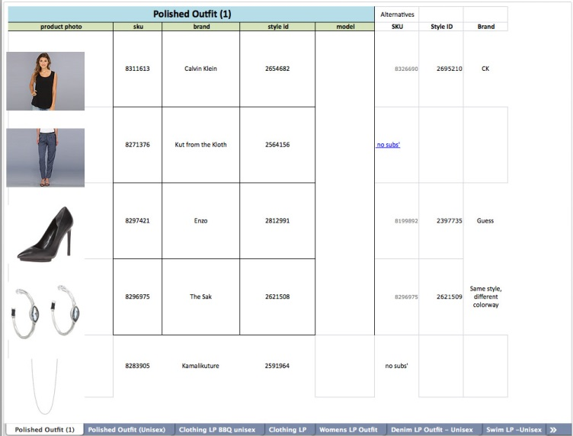

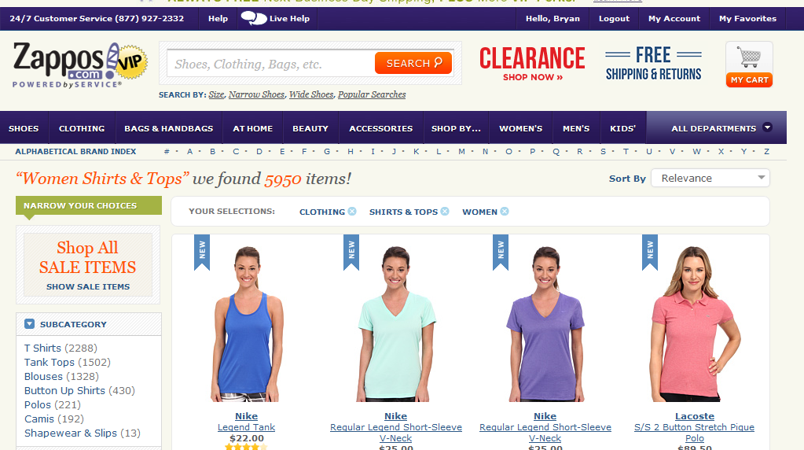
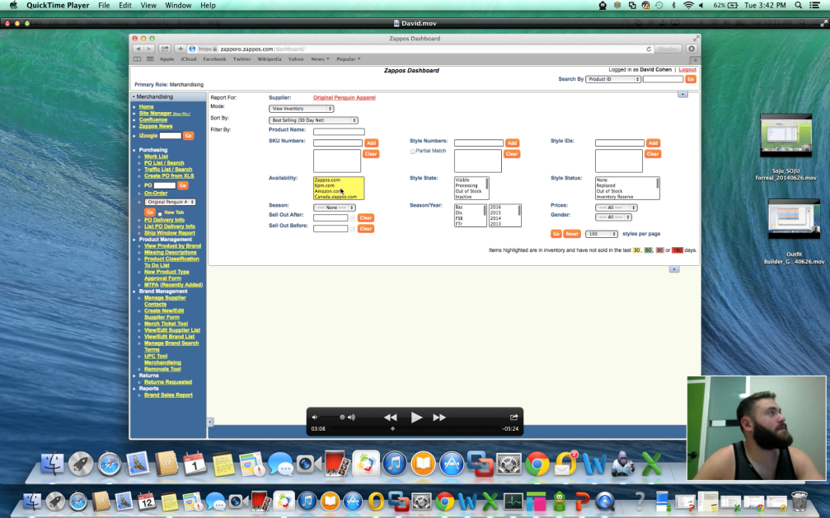
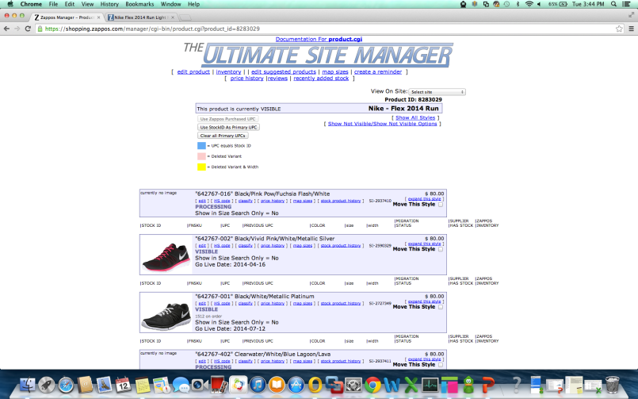
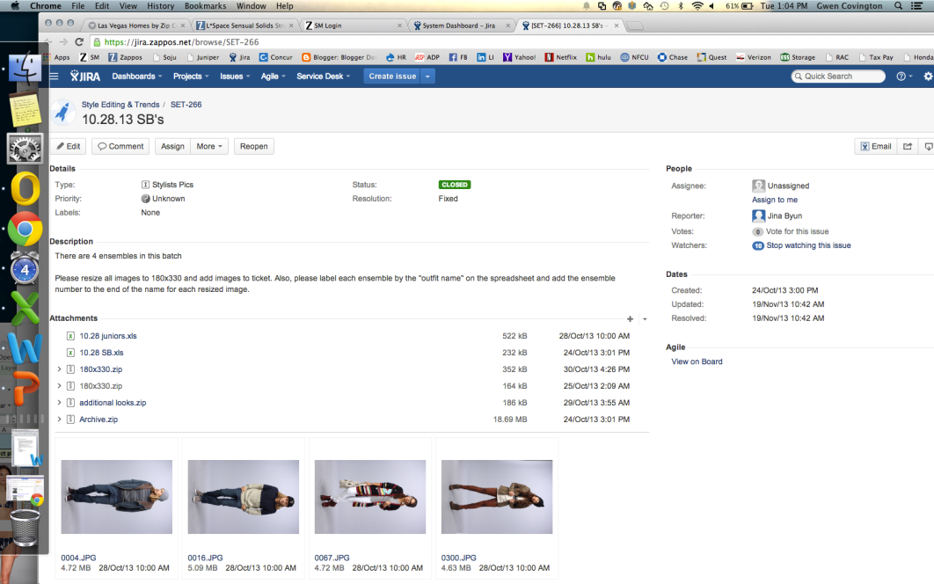
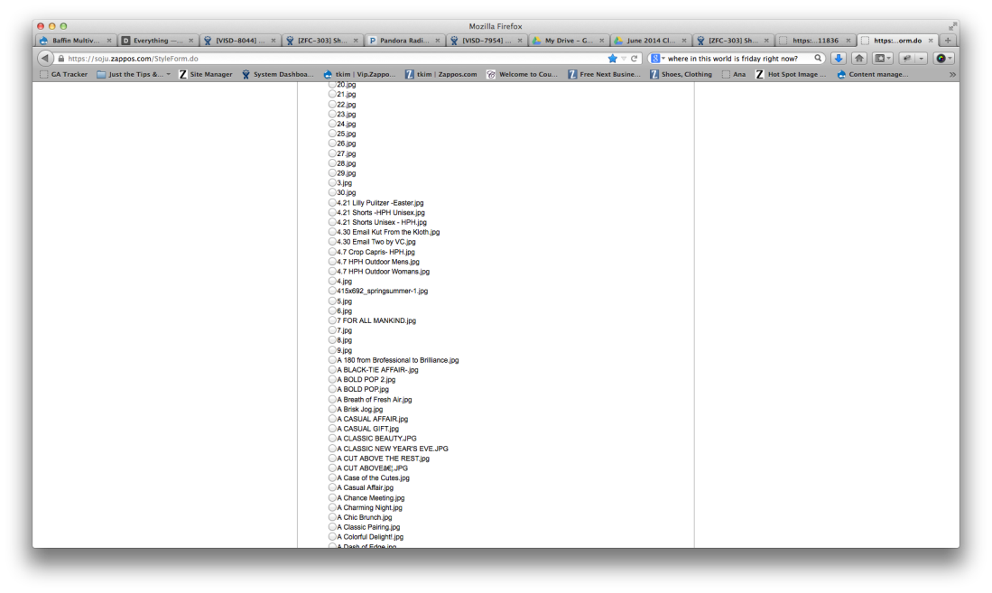
Excel
Google Doc
Zappos VIP
Zapporo
iZoogle
SOJU
JIRA
Notes:
This is meant to be overwhelming.
9 different things are need to be used over a 39 day period to create one outfit on a model and publish it on a website.

Slide 6
Main Considerations
Must be intuitive and streamlined for 6 unique roles consisting of 35 users
Must be technically compatible using Amazon systems/taxonomy
Anticipate outfit building process changes due to migration
Notes:
Must be intuitive and streamlined for 6 unique roles consisting of 35 users
Must be technically compatible using Amazon systems/taxonomy
Anticipate outfit building process changes due to migration

Slide 7
Team Challenges
New to Zappos
New to Outfit Builder
Lack of experience with Scrum
Collaborating in large software dev team
Limited Time
Notes:
Large Dev team – Scrum begins to become more difficult to manage with teams 9 -12 people….we had 9!
Limited time – approx. 6 weeks of actual sprint time.

Slide 8
Our Process
Scrum
  Daily standups
  Sprint planning, review, retro
    Fibonacci sizing
    Demos
    Sticky Notes
Confluence
Ideation sessions
Prototyping and User Testing
Fun!

Slide 9
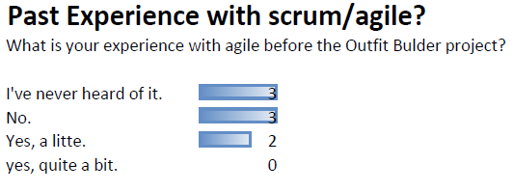
Team Experience with Scrum
Do you have past experience with Agile?
Notes:
I sent out a survey to gauge past experience with agile.
Previously, only 2 members of the team have had experience with scrum.
1/3 of the team has never even heard of it.

Slide 10
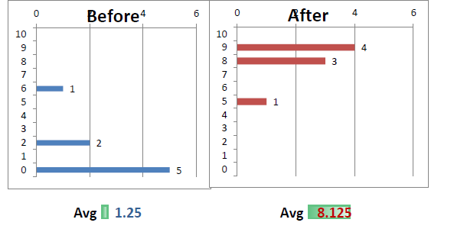
Team Experience with Scrum
Rate your understanding of Agile
Notes:
On a self-rated system from 1-10, Outfit Builder team members rated their understanding of agile at an average of 1.25.
After performing on the Outfit Builder project, the team self-rated their understanding of agile at an average of 8.125.

Slide 11
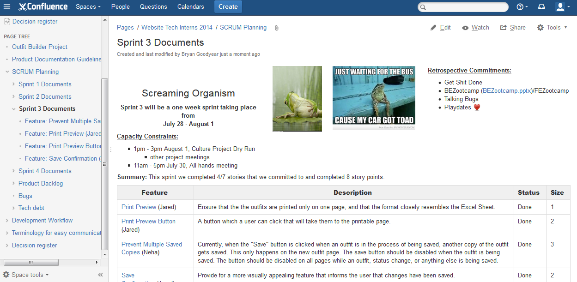
Organization of Features and Backlog
Notes:
We used Confluence to organize our information and communication – the information that would be on JIRA was included on the page.
This is an example of our sprint page with our Sprint name, Retrospective Commitments, and stories committed to in the sprint.

Slide 12
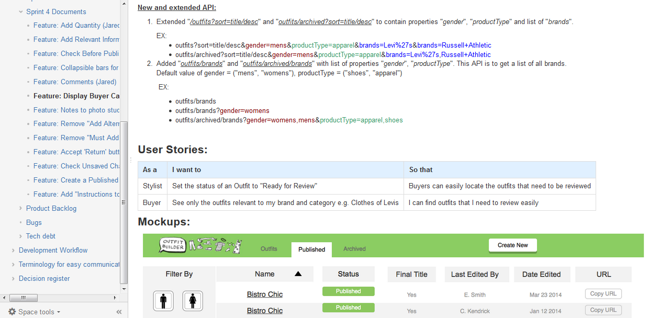
Feature Pages
Notes:
Each feature page had a feature Description, Dev Plan (if necessary), User Stories, Acceptance Criteria, and Mockups (if necessary).
The purpose of these pages is to help the developers have all the resources needed to create the feature.

Slide 13
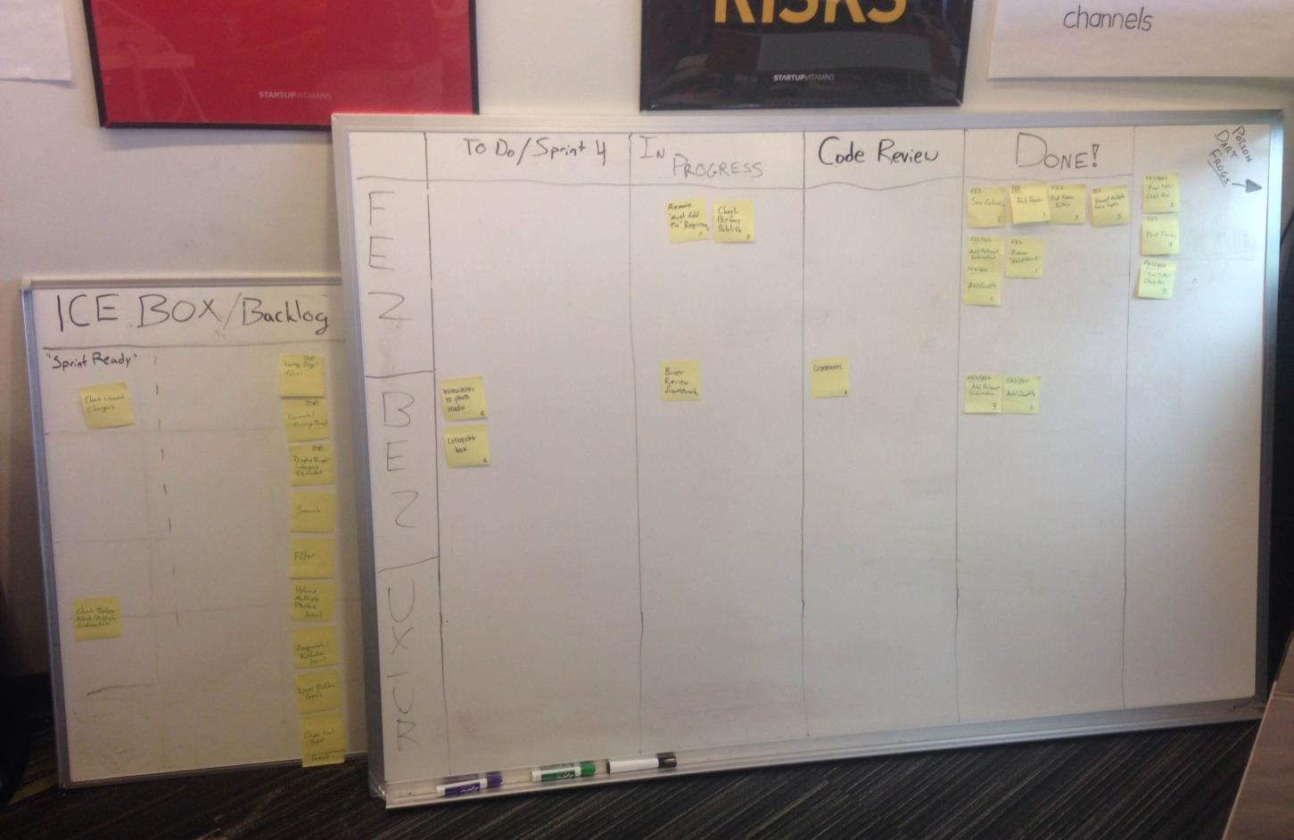
Notes:
Scrum board – used “Code Review” instead of “QA” because we didn’t have a QA resource. Code review – team members who were available
Product Managers tested the features. Bugs went onto a “Bugs” page for review. Bugs were fixed as bandwidth opened up for developers.
“Sprint Ready”

Slide 14
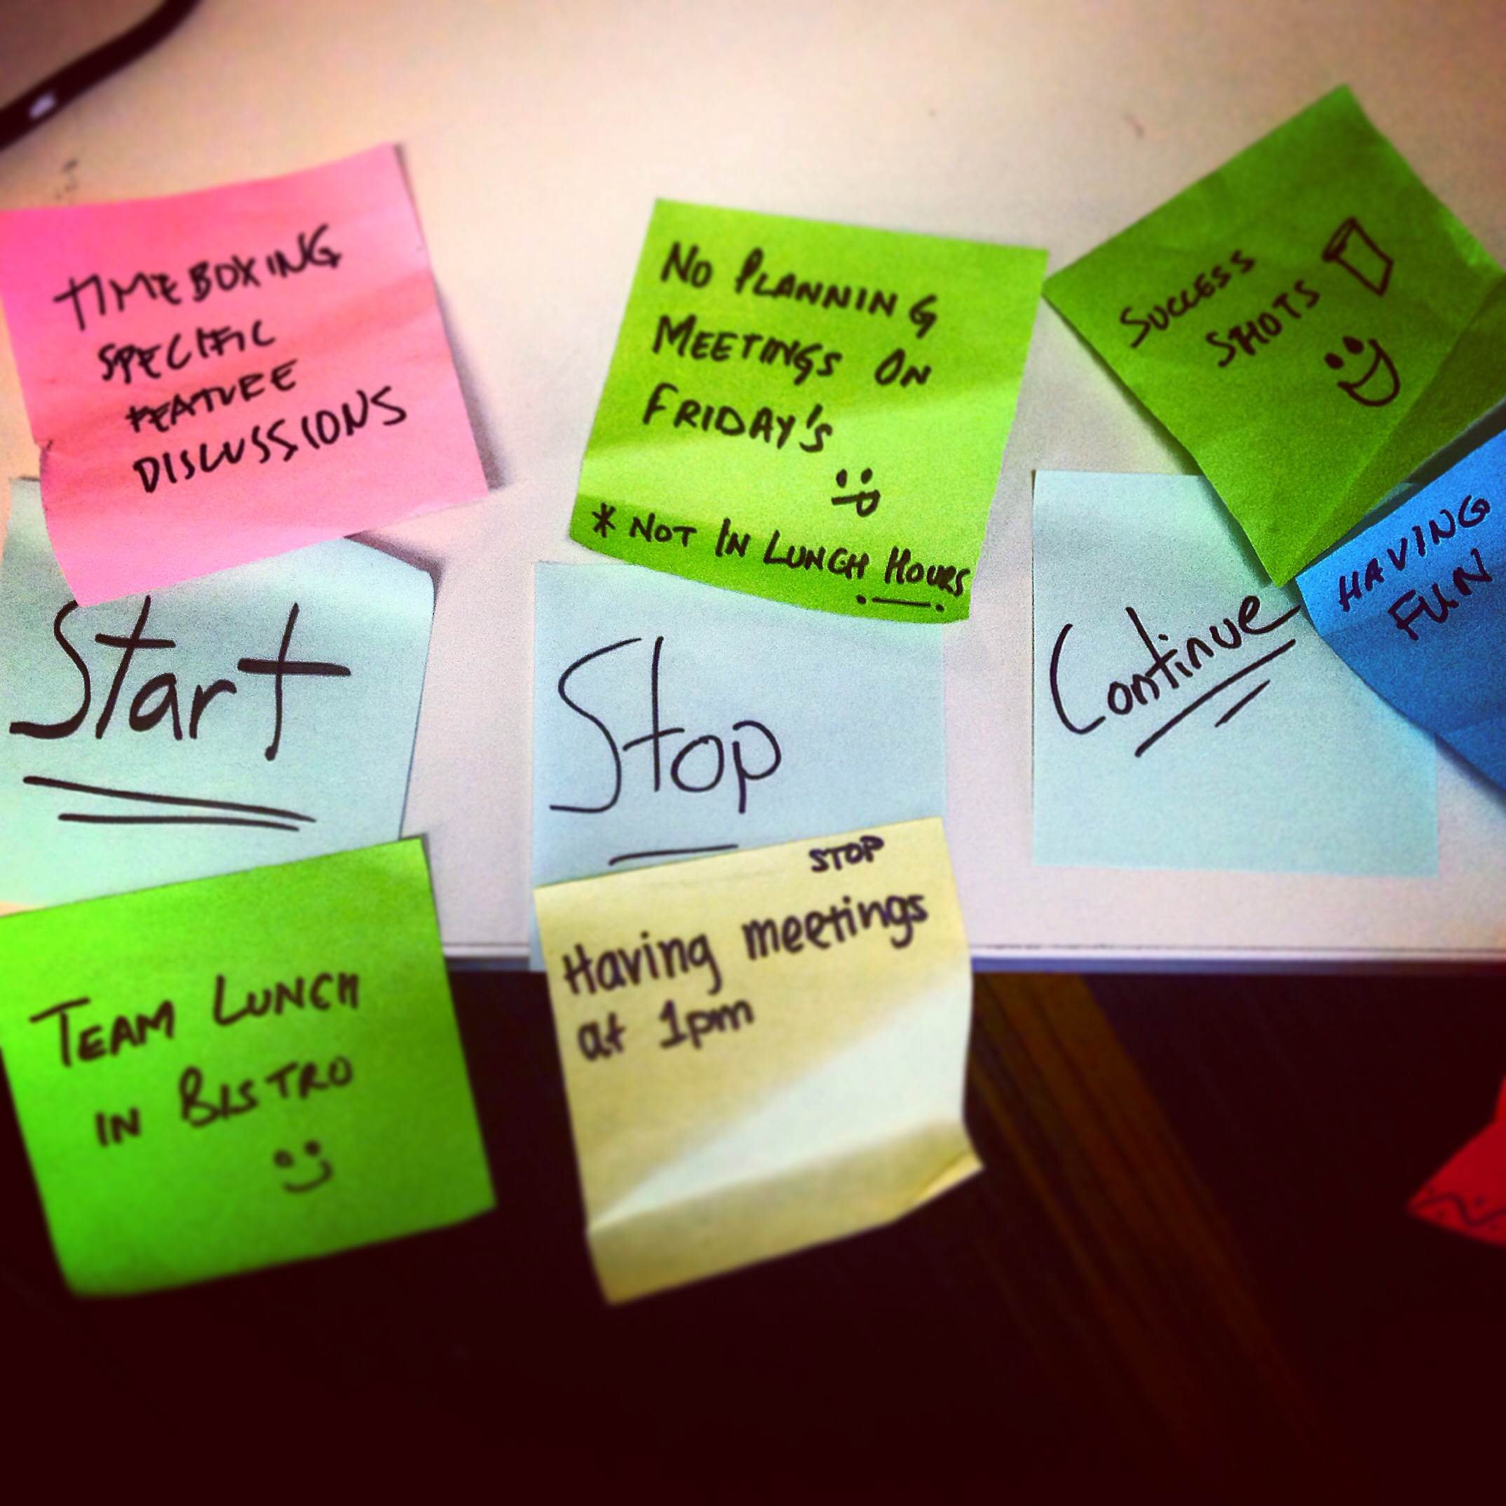
Notes:
We took Retrospectives very seriously as a new team.
We did the “Start” “Stop” “Continue” exercise.
*Briefly talk about some of the sticky notes*

Slide 15
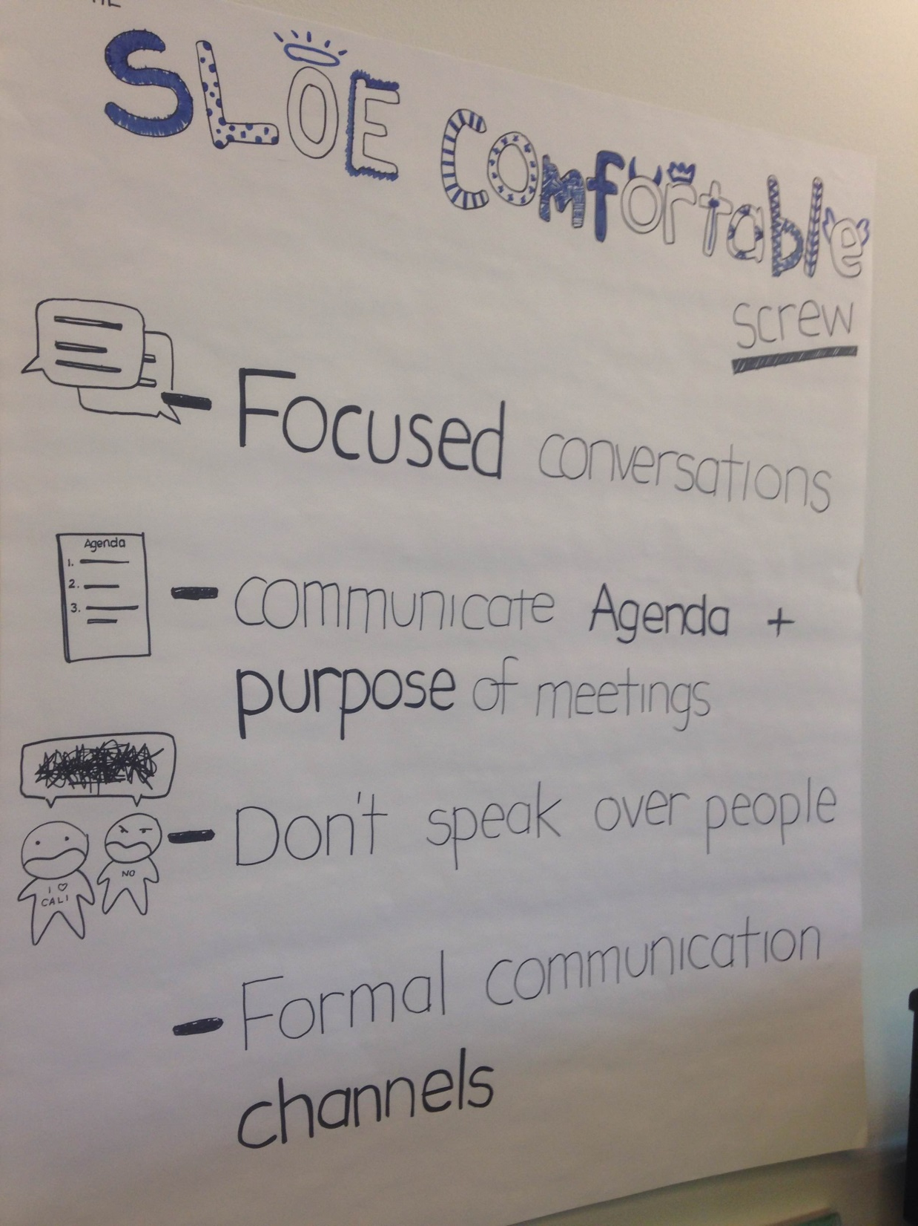
Notes:
Commitments for the next sprint would come out of the retrospectives.
This was the result of our first retrospective – I believe our team was in the “Storming” stage of group development.
Forming, Storming, Norming, Performing

Slide 16
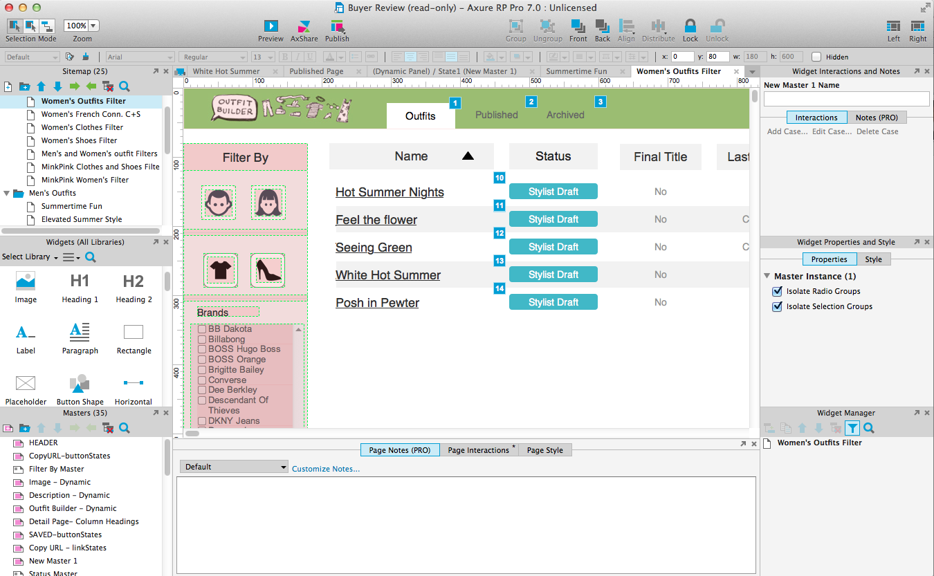
Prototyping
Screen Shot
Notes:
Laurie (UX) created prototypes using Axure for Maggie (UR) to user test and gather feedback.

Slide 17
User Testing
Stylists (2)
Buyers (4)
Site Merchandizing (1)
Photo Studio (1)
THANK YOU
Notes:
*These users will be in the audience*
After one click – “THANK YOU” will appear. Give them a shout out ;)

Slide 18
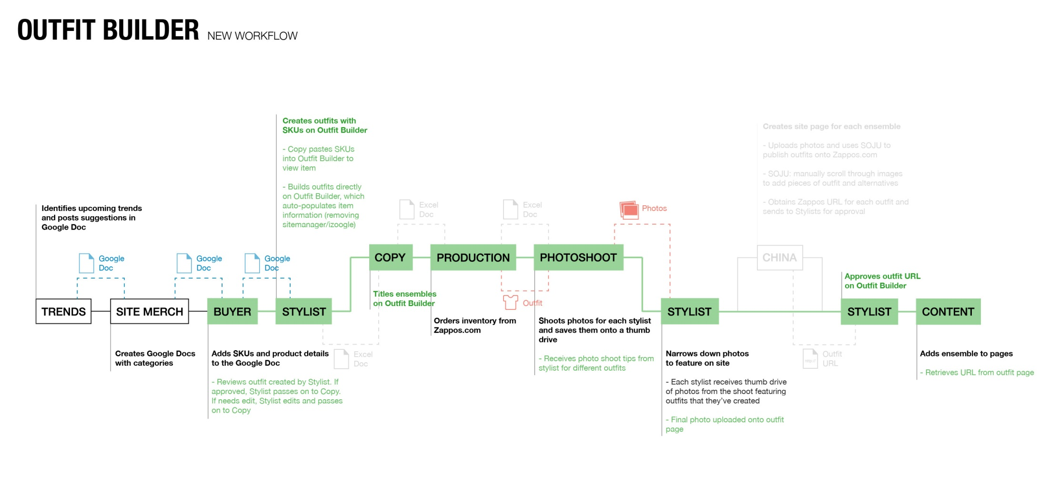
Outfit Builder
Notes:
Outfit builder will streamline the entire process and communication within the box.

Slide 19
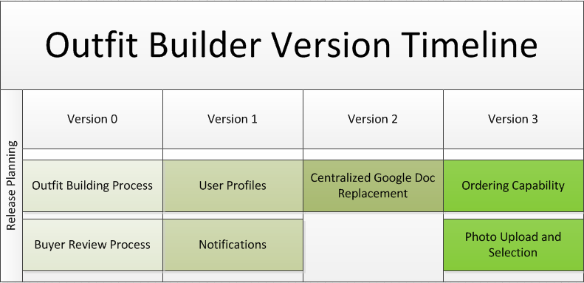
Notes:
RELEASE PLANNING – Our roadmap is in version release planning because we don’t know when a team will pick up the project or how long it will take the next team to complete each version.

Slide 20
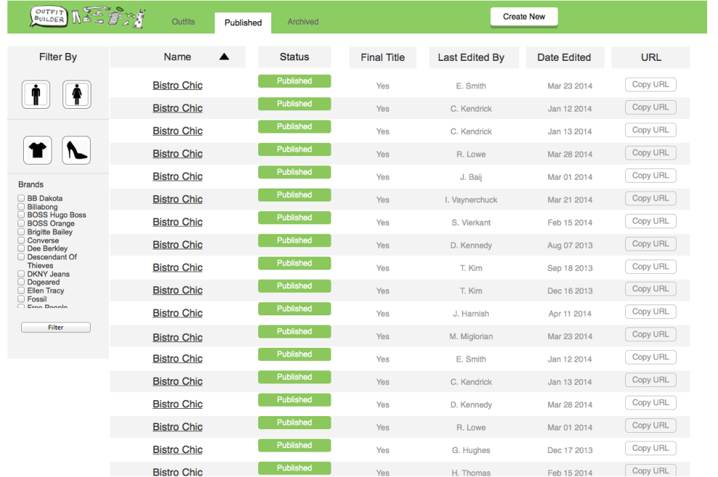
Version 0
Zappos VIP
Google Doc
Outfit Builder
Notes:
USB = manual transfer from photostudio to Stylists
Email icon = some email messaging required
No more JIRA, iZoogle, Zapporo, Excel, or SOJU

Slide 21
Version 0
Version 1
Zappos VIP
Google Doc
Outfit Builder
Notes:
Profiles and Notifications will eliminate direct email.

Slide 22

Version 0
Version 2
Zappos VIP
Outfit Builder
Notes:
Centralized Google Doc Replacement will remove the Google Doc and have the buyers use Outfit Builder earlier in the process.

Slide 23
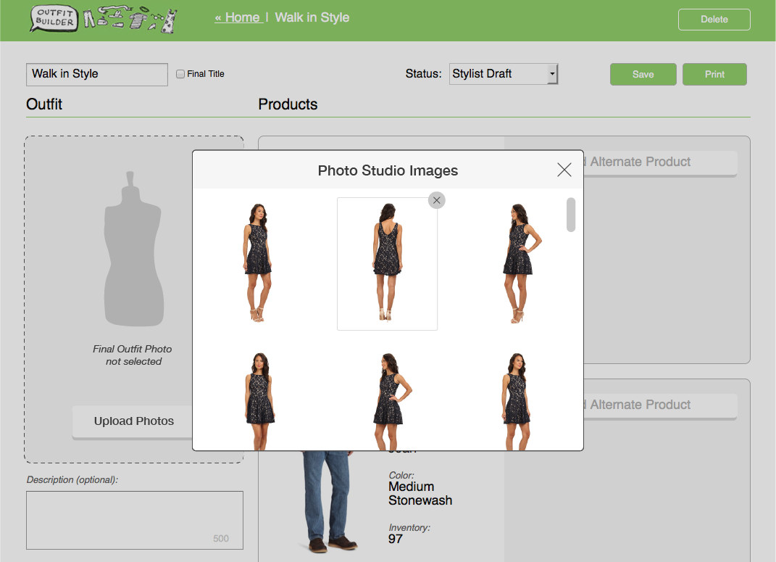
Version 0
Version 3
Zappos VIP
Outfit Builder
Notes:
Ordering Capability and Photo Upload Capability will eliminate the need for manually transferring files between the photostudio and the Stylists. Ordering Capability will assist production in ordering clothes necessary for the model.

Slide 24
Results
New process takes approx. 17 days
39 days – 22 saved (-56%) = 17 days
Currently 80 – 100 outfits created a month
More outfits will be created since the tool will allow them to be built faster.
Notes:
The time saved is due to parts of the process no longer being needed and streamlined communication between users.

